Slide 1
Herd Immunity & Vaccinations

Slide 2
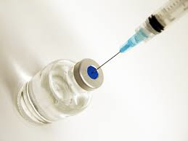
What is Herd Immunity?
A form of immunity that occurs when the vaccination of a large population (herd) provides a measure of protection for individuals who have not developed immunity yet.
Usually happens when a high percentage of a population is protected through a specific vaccination particular to a virus or a bacteria.
This makes it difficult for the disease to spread because there is a smaller number of people that are susceptible to infect.

Slide 3
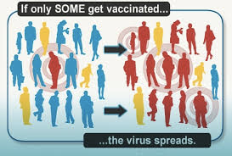
Why is Herd Immunity Important?
Protects against Infections
The more people who are protected, the less the disease will spread

Slide 4
Immunity
Immunity is the ability of our bodies to fight off infection and bacteria.
Infection: the invasion and multiplication of microorganisms that are not normally present within the body.
For Example: viruses, parasites, bacteria
Our cells defend against infections.

Slide 5
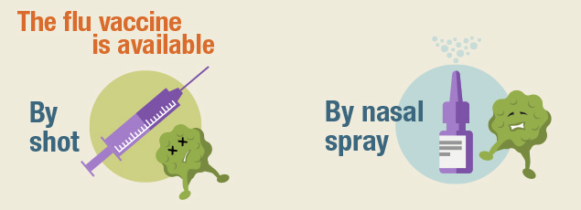
Vaccination
A vaccination is the administration of an antigenic material to stimulate an individual’s immune system to develop adaptive immunity to a pathogen.

Slide 6
Vaccines
Vaccines have the bacteria of the disease that is is trying to prevent.
They do not cause disease because the bacteria are either dead or weakened and the toxins are inactive.

Slide 7
What Is In a Vaccine?
Vaccines have a number of things mixed in them:
Aluminum: helps to boost immune response
Antibiotics: prevents growth of other bacterias
Egg Proteins: growth medium for viruses
Formaldehyde: kills bacteria and viruses, then removed from vaccines
MSG: helps vaccine to remain the same after exposure to heat, light, acidity, and humidity
Thimerosal: mercury preservative added to vaccine vials to prevent contamination form multiple doses

Slide 8
Types of Vaccinations
Live-attenuated: weakened virus
Inactivated: killed virus
Toxoid: weakened toxins
Subunit: part of bacteria or virus
Conjugate: weak bacteria similar to harmful one

Slide 9
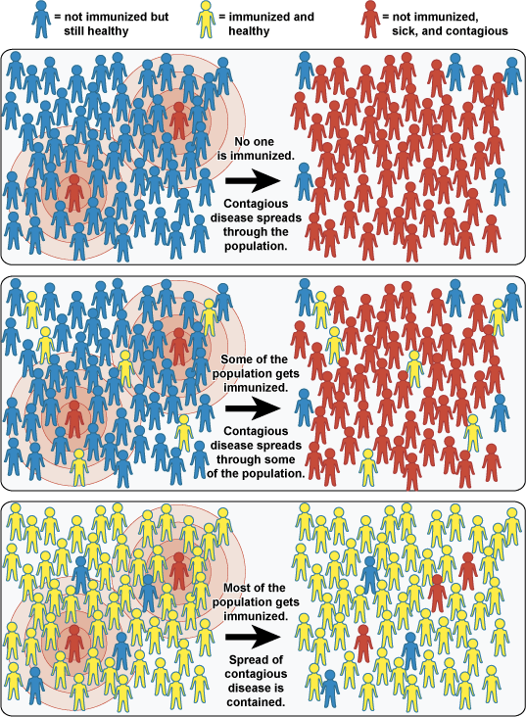
Protecting Yourself & Others
Herd Immunity works when many people in one community get vaccinated.
Protects against outbreaks.

